Slide 1
INTRODUCTORY SET - Look Inside Lesson

Slide 2
INTRODUCTORY SET - Information page
INSIDE OUT has planned 5 weeks of simple lessons that introduce the 5 Keys to Happiness. This set of lessons is intended to be used by school’s that are starting out on their Dive in Journey or at the beginning of a new academic year to introduce/remind staff and children of the 5 Keys. The 5 Keys to Happiness framework is familiar to children and teachers and provides a simple and inspiring way to cover most of the 2020 statutory DfE ‘Relationships Education, RSE and Health Education’ (RSHE) objectives. Lessons are in 2 parts - a WARM-UP and a MAIN ACTIVITY. Teachers can adapt the activities as they wish and link them to existing schemes of work. The RSHE objectives have been broken down into a progression of learning outcomes for Key Stage 1, Lower Key Stage 2 and Upper Key Stage 2 along with an ‘I can..’ statement for the children if needed. Teachers can adapt these outcomes as they wish. Any slide that has an eye with a cross through means that it is hidden in the presentation mode. If you would like to see a slide in the presentation mode, then right click on it and uncheck ‘skip slide’. The ‘white’ slides are for teachers and can be printed for reference to guide the lessons. SUGGESTED READING FOR TEACHERS Mental Wellbeing - teacher training module from the DfE Physical Health and Fitness - teacher training module from the DfE Respectful Relationships - teacher training module from the DfE SET THE GROUND RULES Before starting the block of lessons we encourage you to set some simple ground rules to keep everybody safe and feel supported (as recommended in the Plan your RSHE guidance Sept 2020 under dealing with sensitive issues). The ground rules should be created with the children, to encourage involvement and engagement from every pupil. Example ground rules: Respect each other Listen carefully Questions are welcome during and even after the lesson They will never be expected to share ideas or experiences if they don’t want to SAFEGUARDING If you become concerned about a child’s wellbeing or safety during a lesson, follow your school’s safeguarding policy.

Slide 3
INTRODUCTORY SET - Main ‘Relationships Education, RSE and Health Education’ objectives covered
WEEK 1 Look Inside | WEEK 2 Move Outside | WEEK 3 Share More | WEEK 4 Be Curious | WEEK 5 Be Kind
Mental Wellbeing 1 (this is an overarching objective linked to all the 5 Keys to Happiness) By the end of primary school pupils should know: that mental wellbeing is a normal part of daily life, in the same way as physical health
Mental Wellbeing 3 By the end of primary school pupils should know: how to recognise and talk about their emotions, including having a varied vocabulary of words to use when talking about their own and others’ feelings. | Physical Health and Fitness 2 By the end of primary school pupils should know: the importance of building regular exercise into daily and weekly routines and how to achieve this; for example walking or cycling to school, a daily active mile or other forms of regular, vigorous exercise (only underlined sections covered in this lesson). | Respectful Relationships 2 By the end of primary school pupils should know: practical steps they can take in a range of different contexts to improve or support respectful relationships. | Mental Wellbeing 6 By the end of primary school pupils should know: simple self-care techniques, including the importance of rest, time spent with friends and family and the benefits of hobbies and interests (only underlined sections covered in this lesson). | Respectful Relationships 4: By the end of primary school pupils should know: the importance of self-respect and how this links to their own happiness.
Mental Wellbeing 9 By the end of primary school pupils should know: where and how to seek support (including recognising the triggers for seeking support), including whom in school they should speak to if they are worried about their own or someone else’s mental wellbeing or ability to control their emotions (only underlined sections covered in this lesson).

Slide 4
FBW SCRIPT
The following script is intended to help teachers when using the FBW in class. This does not include the worry walk.
F … Feel your feet resting on the floor.
Children can sit or stand.
B … Feel your breathing - place one hand on your belly and one hand on your chest. If you feel comfortable you can close your eyes.
We’re going to take a few deep breaths. It’s a bit like your belly is a balloon getting bigger and then getting smaller.
Breathe in and feel your belly rise and breathe out and feel your belly fall.
Breathe in 1...2...3… and breathe out 1...2...3...
Breathe in and feel your belly rise and breathe out and feel your belly fall.
Breathe in 1...2...3… and breathe out 1...2...3…
W … Feel your Weather inside - hopefully you're now a bit calmer and your weather inside is sunnier. But remember all weather is welcome.

Slide 5
INTRODUCTORY SET - LOOK INSIDE LESSON - Overview of slides
Below is an overview of the main slides in the lesson with brief descriptions to help guide you. You can adapt the activities/slides as you wish and link them to existing schemes of work.
 | Look Inside INSIDE OUT’s motto is ‘Happy Children Learn Better’ and, as a school, we believe this too. This term we are going to find out what we can do to help improve and look after our own happiness and wellbeing. We are going to find out about the 5 Keys to Happiness. This is the Look Inside Key and it helps us with self reflection, focusing, being quiet and self calming techniques.
 | Feeling the Weather (1) We are going to start with an activity that helps us with self-reflection and to think out how we are feeling. Sometimes it can be hard to describe our feelings so INSIDE OUT uses the weather to describe them. Feelings are like the weather, they are always changing. Plants need rain and sun to grow and just like plants we need all weather, all feelings to be healthy. Here are some feelings, let’s have a go at seeing what weather might describe them. If you feel sad, what weather might you be feeling inside? - e.g. rainy, foggy. If you feel happy, what weather might you be feeling inside? - e.g. sunny. If you feel scared, what weather might you be feeling inside? - e.g. windy.
 | Feeling the Weather (2) We are going to flip it around. We are going to think about the weather and match it to a feeling emoji! If your weather inside is windy, what might you be feeling? - e.g. scared, excited etc. If your weather inside is sunny, what might you be feeling? - e.g. happy, calm. If your weather inside is stormy, what might you be feeling? - e.g. angry, frustrated.
 | FBW If our weather inside is a bit stormy, it is hard to think clearly and concentrate because our weather inside affects how our brain works. INSIDE OUT has created an activity called an FBW and it is used to help calm our mind and body. We can use it ANYWHERE and ANYTIME. F stands for Feet. B stands for Breathing.W stands for Weather. Use the FBW script on slide 4 to have a go at an FBW in class.
 | Stormy inside all the time? Remember that all weather is welcome just like plants need all types of weather to grow but it isn’t healthy to be feeling stormy all the time. If this is happening to you, it is really important that you talk to someone you trust so they can help you. We are going to think about the people we would talk to if we are feeling stormy - people who would help us/people who we trust.
 | Circle of Trust Main Activity - See slide 6 for lesson explanation. Follow the suggested activity on slide 6 or use an activity from your school’s scheme of work.
 | The 5 Keys to Happiness Can anyone remember why we are learning about the 5 Keys? - e.g. to make us happy, to make us feel better, to help us learn ways to look after our own wellbeing, etc. We are learning about the 5 Keys so that we have strategies to use throughout our lives to help us look after our happiness and wellbeing. Wellbeing is about our physical health and our mental health. The 5 Keys help us to look after both. They are the mental health equivalent to the 5 fruits and veg a day!
 | What have we found out today? Assessment opportunity linked to the main learning points of the lesson.

Slide 6
INTRODUCTORY SET - LOOK INSIDE LESSON - Lesson plan
Set-Up | Gather resources: pencils, coloured pencils or pens, scissors Print and photocopy templates
RHSE main objectives covered in this lesson | By the end of primary school pupils should know: Mental Wellbeing 1: that mental wellbeing is a normal part of daily life, in the same way as physical health. Mental Wellbeing 3: how to recognise and talk about their emotions, including having a varied vocabulary of words to use when talking about their own and others’ feelings. Mental Wellbeing 9: where and how to seek support (including recognising the triggers for seeking support), including whom in school they should speak to if they are worried about their own or someone else’s mental wellbeing or ability to control their emotions (only underlined sections covered in this lesson)
Key Stage 1 (KS1) LEARNING OUTCOMES Children can name people they trust to help them. I CAN STATEMENT I can name people who I trust to help me. |  |  |  |  | Lower Key Stage 2 (LKS2) LEARNING OUTCOMES Children can identify a network of people who they trust to help them. I CAN STATEMENT I can identify a network of people who I trust to help me. |  |  | Upper Key Stage 2 (UKS2) LEARNING OUTCOMES Children can consider the most important people they trust to help them. I CAN STATEMENT I can consider the most important people I trust to help me.
WARM-UP ACTIVITY FEELING THE WEATHER (1) - slide 10 Match the feeling to the weather and discuss why. FEELING THE WEATHER (2) - slide 11 Match the feeling to the the emoji and discuss why. FBW - slide 12 As a class try an FBW (script found on slide 4) and think about when you might use an FBW - e.g. before a test, to help you calm down, before going to sleep etc.
MAIN ACTIVITY STORMY INSIDE ALL THE TIME? - slide 13 Remind children that all weather is welcome just like plants need all types of weather to grow but it isn’t healthy to be feeling stormy all the time. If this is happening to you, it is really important that you talk to someone you trust so they can help you. CIRCLE OF TRUST - slide 14 Explain that we are going to think about the people we would talk to if we are feeling stormy inside or if we are ever worried about someone else. Discuss the people who they would talk to/who they trust. Children to then draw pictures of people they trust, (template on slide 7 if needed), cut out & label. Create a ‘Circle of Trust’ display for the whole class (see example on slide 7). Explain that Childline is a free confidential number you can ring day or night to talk to a trusted adult - open website and share as appropriate. If the children completed this activity last year, explain that this is the term where we remind ourselves of these people as it it important to think about who would help us and maybe we have new people we would like to include. THE 5 KEYS TO HAPPINESS - slide 15 Can anyone remember why we are learning about the 5 Keys? - e.g. to make us happy, to help us learn ways to look after our own wellbeing, etc. The 5 Keys help us learn strategies to use throughout our lives to look after our happiness and wellbeing. Wellbeing is about our physical health and our mental health. The 5 Keys help us to look after both -they are the mental health equivalent to the 5 fruits and veg a day! |  |  |  |  | MAIN ACTIVITY STORMY INSIDE ALL THE TIME? - slide 13 Remember that all weather is welcome just like plants need all types of weather to grow but it isn’t healthy to be feeling stormy all the time. If this is happening to you, it is really important that you talk to someone you trust so they can help you. CIRCLE OF TRUST - slide 14 Explain that we are going to think about the people we would talk to if we are feeling stormy inside or if we are ever worried about someone else. Give out the LKS2 template on slide 8 and talk through the sections. Children to complete their own individual ‘Circle of Trust’. These could be saved so that you can go back each term to remind children who they would choose to talk to if they needed help. Explain that Childline is a free confidential number you can ring day or night to talk to a trusted adult - open website and share as appropriate. If the children completed this activity last year, explain that this is the term where we remind ourselves of these people as it it important to think about who would help us and maybe we have new people we would like to include. THE 5 KEYS TO HAPPINESS - slide 15 Can anyone remember why we are learning about the 5 Keys? - e.g. to make us happy, to help us learn ways to look after our own wellbeing, etc. The 5 Keys help us learn strategies to use throughout our lives look after our happiness and wellbeing. Wellbeing is about our physical health and our mental health. The 5 Keys help us to look after both -they are the mental health equivalent to the 5 fruits and veg a day! |  |  | MAIN ACTIVITY STORMY INSIDE ALL THE TIME? - slide 13 Remember that all weather is welcome just like plants need all types of weather to grow but it isn’t healthy to be feeling stormy all the time. If this is happening to you, it is really important that you talk to someone you trust so they can help you. CIRCLE OF TRUST - slide 14 Explain that we are going to think about the people we would talk to if we are feeling stormy inside or if we are ever worried about someone else. Give out the UKS2 template on slide 8 and explain that the children are to complete their own individual ‘Circle of Trust’, thinking about who they would put closest to the centre (‘me)’. These could be saved so that you can go back each term to remind children who they would choose to talk to if they needed help. Explain that Childline is a free confidential number you can ring day or night to talk to a trusted adult - open website and share as appropriate. If the children completed this activity last year, explain that this is the term where we remind ourselves of these people as it it important to think about who would help us and maybe we have new people we would like to include. THE 5 KEYS TO HAPPINESS - slide 15 Can anyone remember why we are learning about the 5 Keys? - e.g. to make us happy, to help us learn ways to look after our own wellbeing, etc. The 5 Keys help us learn strategies to use throughout our lives look after our happiness and wellbeing. Wellbeing is about our physical health and our mental health. The 5 Keys help us to look after both -they are the mental health equivalent to the 5 fruits and veg a day!
ASSESSMENT Can the children REMEMBER the main points of the lesson? |  |  |  |  | ASSESSMENT Do the children UNDERSTAND the main points of the lesson? |  |  | ASSESSMENT Can the children APPLY the main points of the lesson?

Slide 7
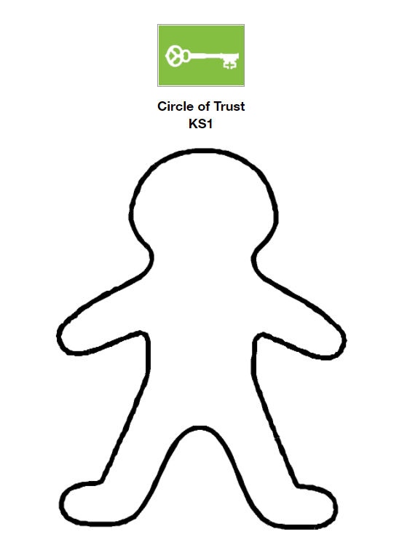
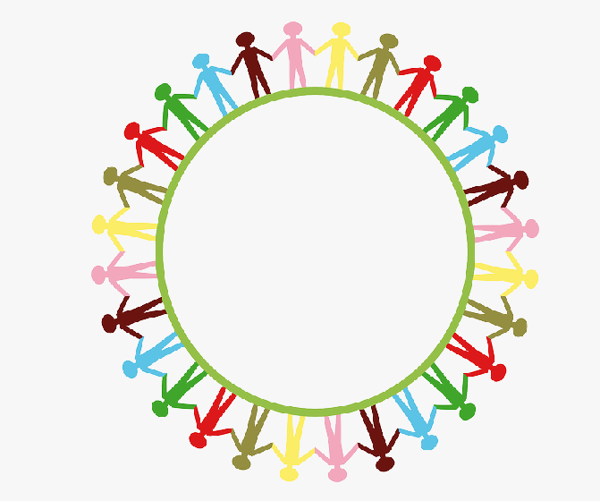
Click here to download/print
KS1 Template
Example of possible way to display

Slide 8
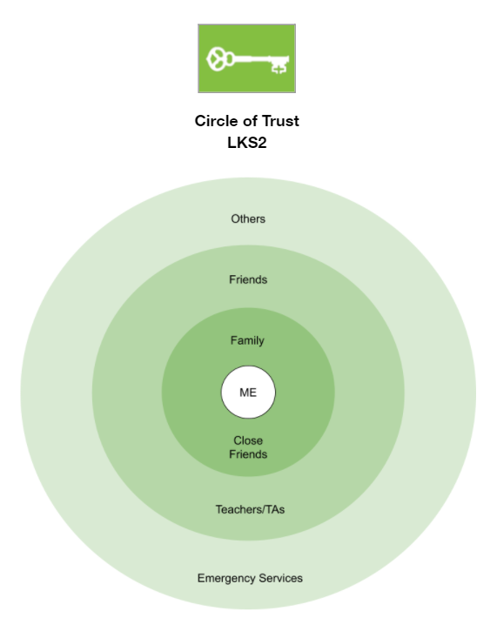
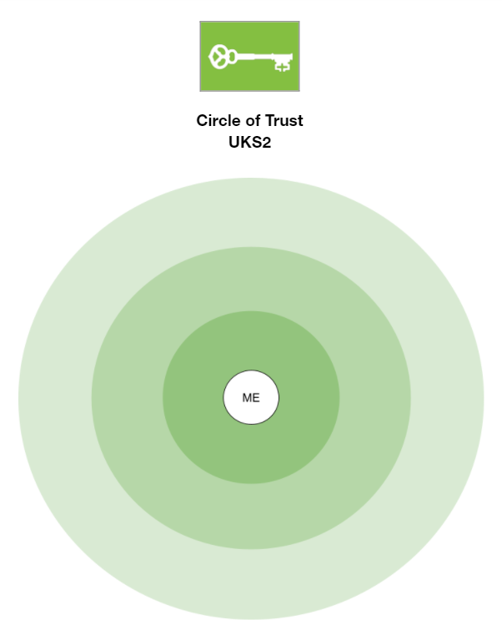
Click here to download/print
LKS2 Template
Click here to download/print
UKS2 Template

Slide 9
Look Inside
Inspires self reflection, being quiet and self calming.

Slide 10
Feeling the Weather
Sad
Happy
Scared

Slide 11
Feeling the Weather
Windy
Sunny
Stormy

Slide 12
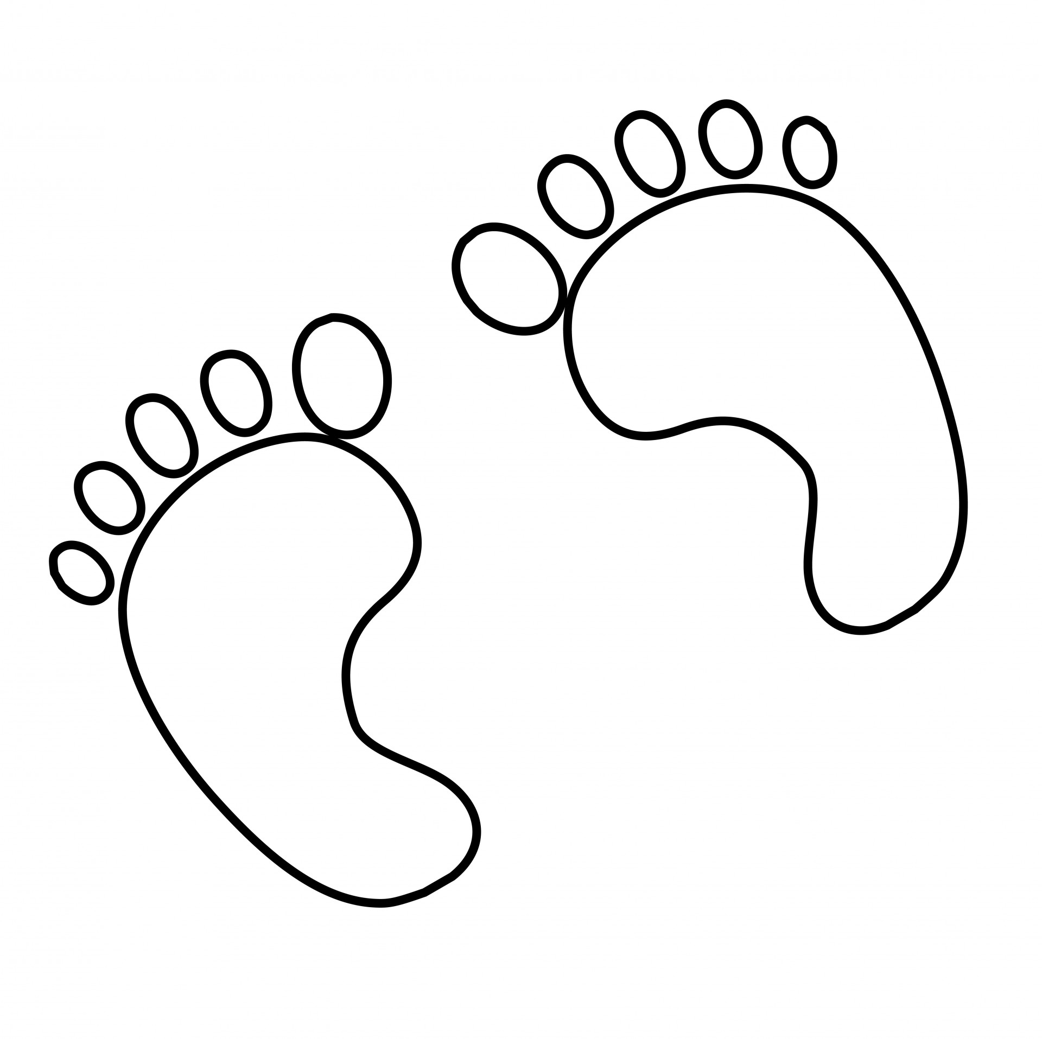
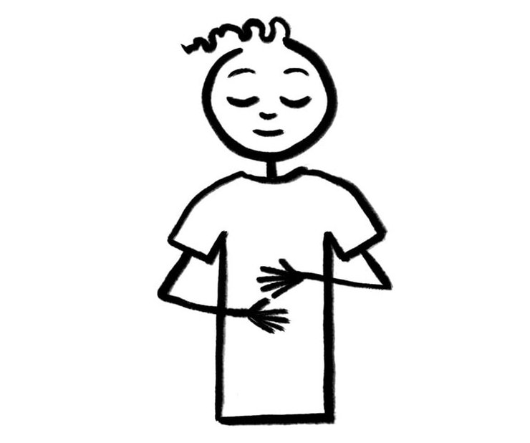
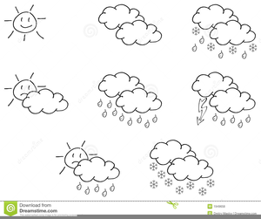
F B W

Slide 13
Stormy inside all the time?
Who would you talk to?

Slide 14
Circle
of
Trust

Slide 15
The 5 Keys to Happiness
Look Inside
Inspires self reflection, being quiet and self calming
Move Outside
Promote non-competitive outdoor exercise
Share More
Encouraging connection, teamwork and communication
Be Curious
Stimulating growth mindsets, exploration, experimentation and making
Be Kind
Supporting an attitude of caring for oneself, others and the environment

Slide 16
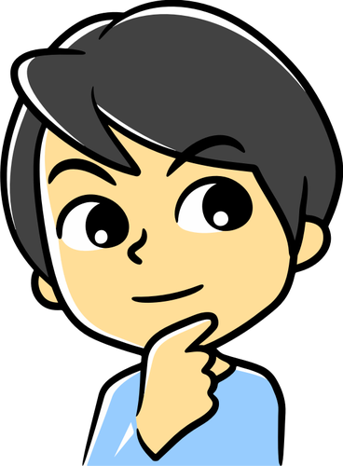
What have we found out today?

