Slide 1
INTRODUCTORY SET - Look Inside Assembly

Slide 2
LOOK INSIDE ASSEMBLY - Information Page
Set-Up | Display the Look Inside Focus Poster Set up the slide presentation and ensure that it is working Print out The ‘Key to Happiness’ story on slide 4.
Aims | To provide the whole school with an introduction to the 5 Keys to Happiness over 5 assemblies To instill a sense of excitement and anticipation around the Keys using the fun, simple assembly format To motivate staff to use the Toolbox resources to improve happiness and wellbeing To begin to meet specific objectives of Relationships Education and Health Education that link to the Keys (see below) To introduce the warm up activity that will be completed in the lesson
Outcomes | By the end of the 5 assemblies, the following will be introduced: 5 Keys to Happiness Children to be able to name the 5 Keys to Happiness and begin to understand how they can help look after their happiness and wellbeing. Relationships Education, RSE and Health Education By the end of primary school pupils should know: Mental Wellbeing Mental Wellbeing 1: that mental wellbeing is a normal part of daily life, in the same way as physical health (this is an overarching objective linked to all the 5 Keys to Happiness). Mental Wellbeing 3: how to recognise and talk about their emotions, including having a varied vocabulary of words to use when talking about their own and others’ feelings. Mental Wellbeing 6: simple self-care techniques, including the importance of rest, time spent with friends and family and the benefits of hobbies and interests. Mental Wellbeing 9: where and how to seek support (including recognising the triggers for seeking support), including whom in school they should speak to if they are worried about their own or someone else’s mental wellbeing or ability to control their emotions (only underlined sections covered in this lesson). Respectful Relationships Respectful Relationships 2: practical steps they can take in a range of different contexts to improve or support respectful relationships. Respectful Relationships 4: the importance of self-respect and how this links to their own happiness. Physical Health and Fitness 2 Physical Health and Fitness 2: the importance of building regular exercise into daily and weekly routines and how to achieve this; for example walking or cycling to school, a daily active mile or other forms of regular, vigorous exercise (only underlined sections covered in this lesson).
Please Note | We do not cover these sections of the Relationships Education, RSE, and Health Education - Schools to use their own schemes of work for these areas. Internet Safety and Harms, Online Relationships, Changing Adolescent Body, Drugs, Alcohol and Tobacco We do not cover the following specific objectives - Schools to use their own schemes of work for these areas. Respectful relationships 6 (about bullying and cyberbullying), Being Safe 1, 2, 3, 4, 5 and 7 (about personal boundaries, appropriate contact, recognise feelings of being unsafe, how to report concerns or abuse).

Slide 3
LOOK INSIDE ASSEMBLY - Overview of slides
Any slide that has an eye with a cross through means that it is hidden in the presentation mode. If you would like to see a slide in the presentation mode then right click on it and uncheck ‘skip slide’.
 | The Key to Happiness We are going to start today with a story called ‘The Key to Happiness’. Read the story on slide 4. What do you think it means when we say: ‘The key to happiness is inside ourselves?’ Take ideas - e.g. we can all do things that make us happy, it is up to us to make sure we look after ourselves and understand what helps us to feel happy etc. So what things make us happy? What makes you happy? Take ideas from children and staff. Lots of different things make us happy which is why we say the Key to Happiness is inside ourselves.
 | Can we be happy all the time? But can we be happy all the time? What do you think? Take ideas. Does anyone know what film this picture is from? It’s the film Inside Out - nothing to do with the children’s charity we are working with but it teaches the same thing - importance of feelings! Can you name the feelings that we meet inside the main character, the girl called Riley? Joy, Sadness, Anger, Disgust, Fear. What does the film teach us about Sadness? Sadness is just as important as all the other feelings. Joy tries to push away Sadness at the start with but then learns that Sadness is just as important as the rest. ALL FEELINGS have an important role to play and we need to learn to recognise how we are feeling and ways we can look after ourselves.
 | How do we look after ourselves? What is this picture telling us? ‘Eat at least 5 fruits and veg a day’. Why do we have to eat 5 a day? Take ideas - e.g. to help keep our bodies healthy, to get the right vitamins and minerals. What other things do we need to look after ourselves? Take ideas - e.g. have the right amount of sleep, exercise, spend sensible amounts of time on electronic gadgets etc. These are all the things we do to look after our body, our physical health. What things should we do to look after our mind and our feelings, our mental health and our happiness? Take ideas. INSIDE OUT is going to teach us.
 | The 5 Keys to Happiness A few years ago the government set up a research team to find out what people across the world did to look after and improve their happiness. They found 5 common themes across all the people they asked. INSIDE OUT has taken these 5 themes and developed the ‘5 Keys to Happiness’. The 5 Keys help us look after our mind and our feelings, our mental health. Looking after our mental health is just as important as looking after our physical health. The ‘5 Keys to Happiness’ are the mental health equivalent to the 5 fruits and veg a day!
 | Look Inside Key This week we are going to take a look at the Look Inside Key. The Look Inside Key is to help us with self reflection, focusing, being quiet and self calming. How or when do you think the Look Inside Key will help? Take children’s ideas - e.g. when we need to calm down after playtime, if we are feeling a bit cross etc.
 | Feeling the Weather Today we are going to have a go at one of the Look Inside self reflection activities called ‘Feeling the Weather’. Sometimes it can be hard to describe our feelings so INSIDE OUT has come up with using the weather to describe them. Feelings are like the weather, they are always changing. What do plants need to grow? They need rain and sun, and just like plants we need all weather, all feelings to be healthy. Let’s have a look at some feelings and have a go at seeing what weather might describe them. If you feel worried, what weather might you be feeling inside? Take children’s ideas. If you feel excited, what weather might you be feeling inside? Take children’s ideas. If you feel calm, what weather might you be feeling inside? Take children’s ideas.
 | Feeling the Weather continued... Ok now we are going to flip it around. We are going to think about the weather and match it to a feeling emoji! If your weather inside is rainy, what might you be feeling? Take children’s ideas. If your weather inside is foggy, what might you be feeling? Take children’s ideas. If your weather inside is sunny, what might you be feeling? Take children’s ideas. This week I want you to have a go at the ‘Feeling the Weather’ and an ‘FBW’ in class.
 | Let’s Sing! ‘Happy’ by Pharrell Williams Video embedded into the slide. OR school to insert own song.
 | F B W - Feet Breathe Weather We are going to finish with an FBW .INSIDE OUT has created an activity called an FBW and it is used to help calm our mind and body. If our weather inside is a bit unsettled like stormy or windy it can be hard to think clearly and concentrate, because our weather inside affects how our brain works. We can use it ANYWHERE and ANYTIME. F stands for Feet. B stands for Breathing. W stands for Weather. Follow the FBW script on slide 5 to have a go at an FBW.

Slide 4
‘The Key to Happiness Story’.
A group of ancient beings were sitting around a sacred circle, trying to decide where to hide the key to the secrets of happiness.
“The key is very powerful” said one.
“We must put the key to happiness and power in a place where no one will find it”, another said.
“Let’s put the key at the top of the mountain”, said a third. “No one will be able to get it there.”
“Yes. This is a good idea”, everyone agreed. But, as they talked, they realised that one day people might muster the courage and harness the technology to climb to the top of the mountain. The key to happiness and power was not safe there.
“What about putting it at the bottom of the ocean”, suggested another elder. “It will be safe there.”
“Yes. This is a good idea”, everyone agreed. But, talking more, they started to ask what would happen if a flicker of a glimmer of the key got it noticed by a fish, who ate it, only to be caught by a fisherman? So the key to happiness and power was not safe there.
After a long discussion, the youngest of the elders raised his hand. “I know where we can hide the key”, he said, shyly. “I know a place where no human will ever imagine looking.”
“Please tell us”, they replied, having exhausted all ideas.
“The place where humans will never ever imagine looking for the key to the secret of happiness is... inside themselves.”

Slide 5
FBW SCRIPT
If our weather inside is a bit unsettled, for example stormy or windy, it can be hard to think clearly and concentrate as our weather inside affects how our brain works. INSIDE OUT has created an activity called an FBW and it is used to help calm our mind and body. We can use it ANYWHERE and ANYTIME.
F stands for Feet. B stands for Breathing.W stands for Weather.
Let’s have a go at an FBW together. Children can stay seated or stand.
F … Feel your feet resting on the floor.
B … Feel your breathing - place one hand on your belly and one hand on your chest. If you feel comfortable you can close your eyes.
We’re going to take a few deep breaths, when you breathe in you are going to feel your belly rise and when you breathe out feel your belly fall.
It’s a bit like your belly is a balloon getting bigger and then getting smaller.
Breathe in and feel your belly rise 1...2...3...
Breathe out and feel your belly fall 1...2...3...
Breathe in 1...2...3...
Breathe out 1...2...3...
Breathe in 1...2...3...
Breathe out 1...2...3...
W … Now feel your Weather inside - hopefully you are feeling calm and your weather inside is sunny.
Remember all weather is welcome but if you do feel stormy or your weather is unsettled all the time you must talk to someone you trust who can help you.

Slide 7
Can we be happy all the time?

Slide 8
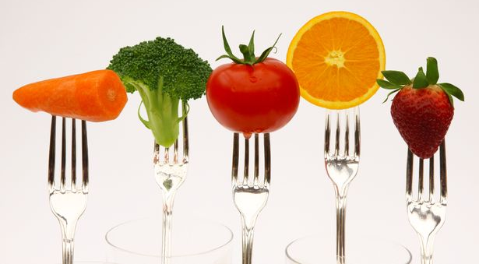
How do we look after ourselves?

Slide 9
The 5 Keys to Happiness

Slide 10
Look Inside
Inspires self reflection, being quiet and self calming.

Slide 11
Feeling the Weather
Worried
Excited
Calm

Slide 12
Feeling the Weather
Rainy
Foggy
Sunny

Slide 13
Let’s sing!

Slide 14
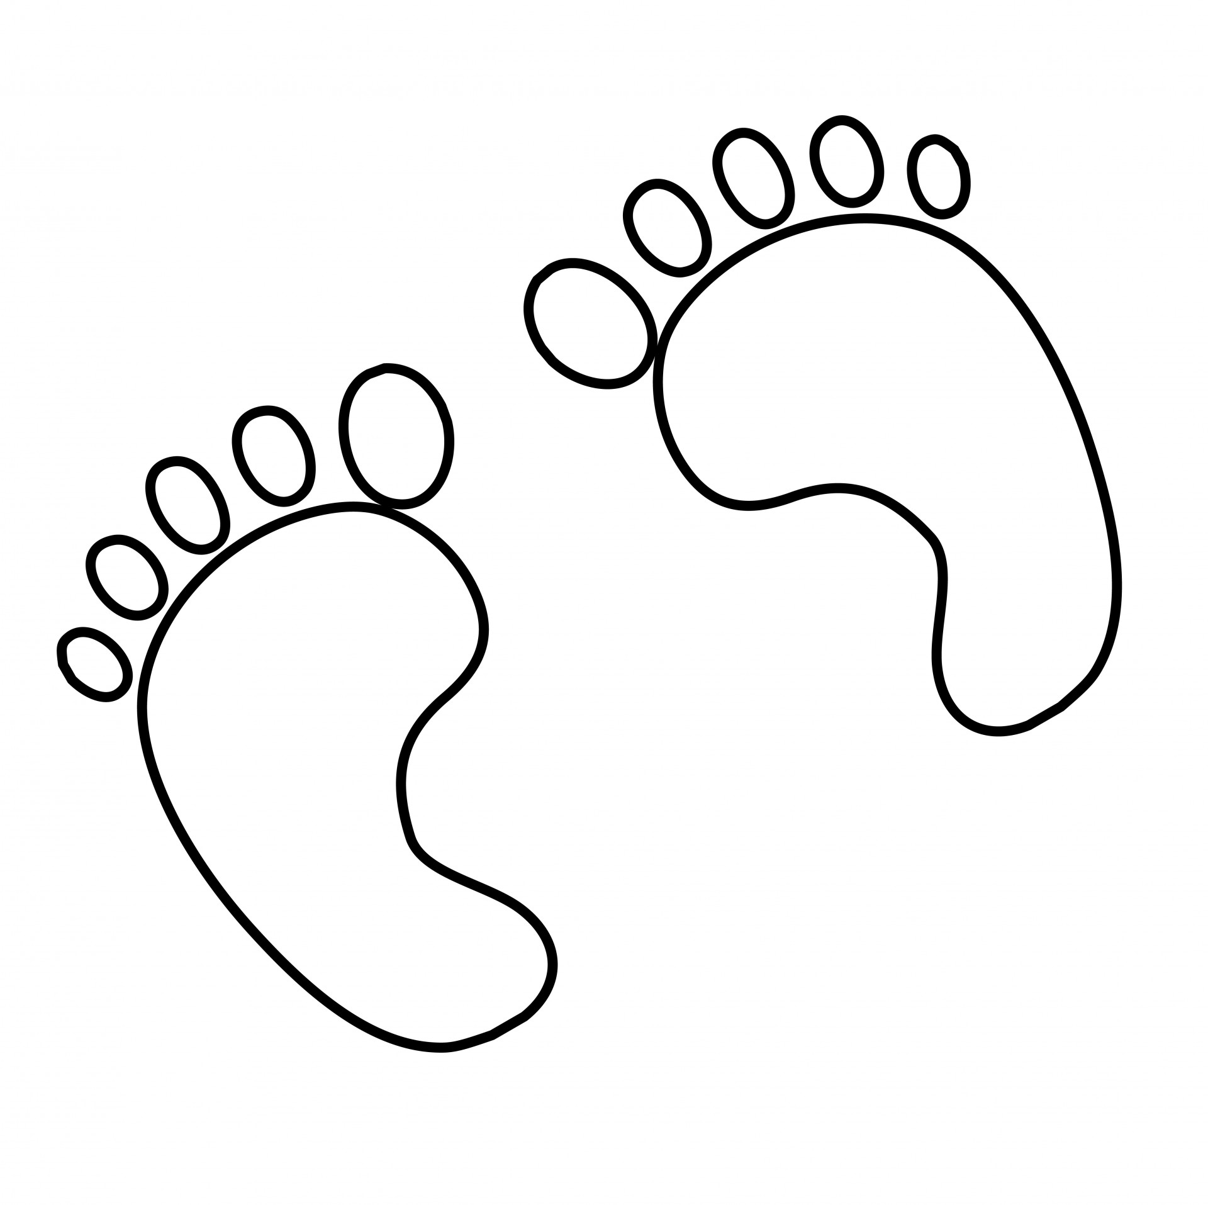
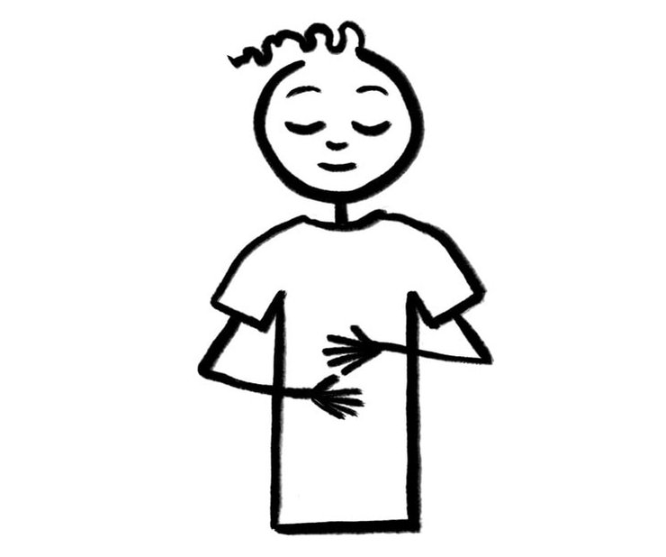
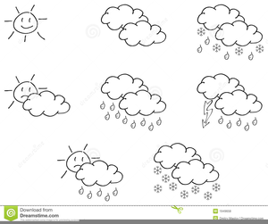
F B W

